Slide 1


Slide 2
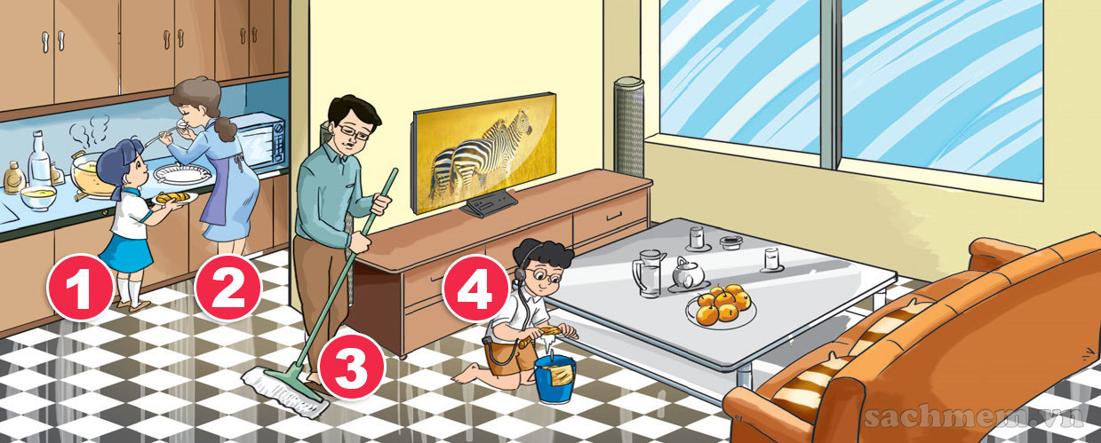

Slide 3
Unit 18: What are you doing?
Lesson 2

Slide 4
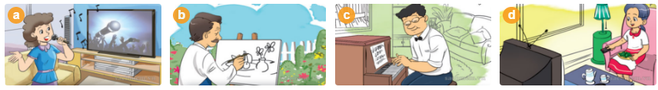
Vocabulary

Slide 5
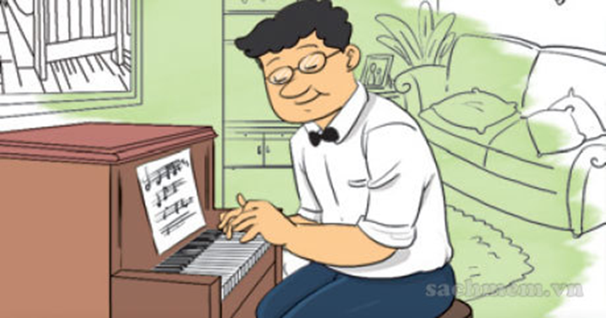
Vocabulary

Slide 6
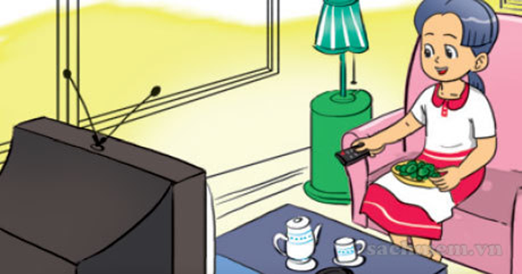
Vocabulary

Slide 7
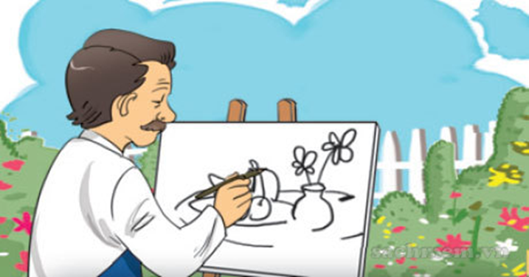
Vocabulary

Slide 8

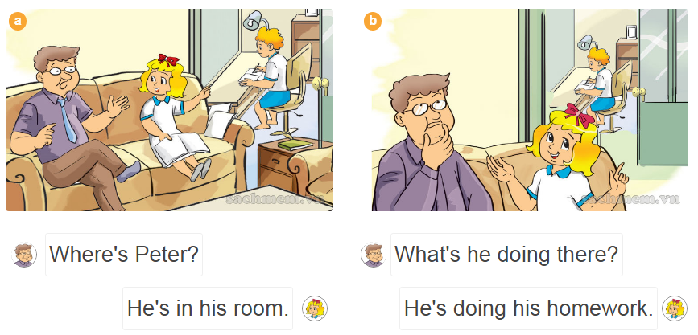
1.Look, listen and repeat:

Slide 9
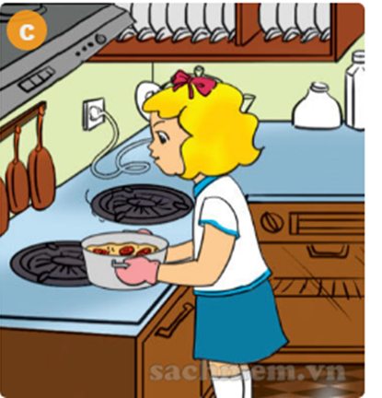
Model sentence :
What is she/ he doing ?
(Cô ấy/ anh ấy đang làm gì?)
She / he is + V- ing.
( Cô ấy/ anh ấy đang …)
What is she doing?
She is cooking.

Slide 10


2.Point and say
What’s she doing?
She’s …

Slide 11


2.Point and say
What’s he doing?
He’s …

Slide 12
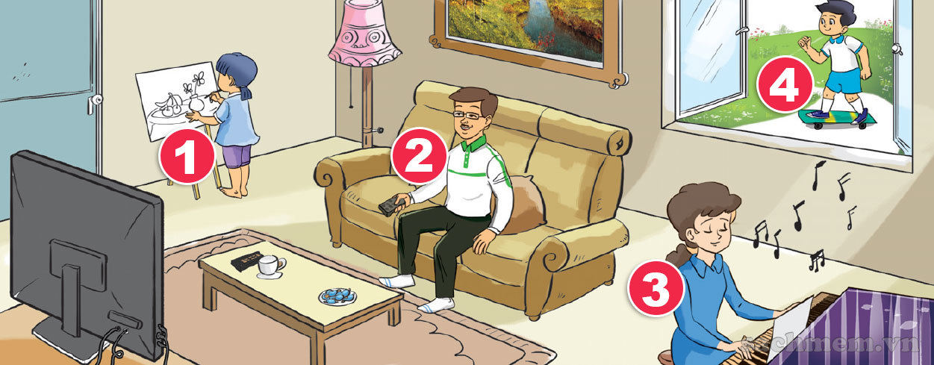
3.Let’s talk

Slide 13

4.Listen and number
3
1
4
2

Slide 14
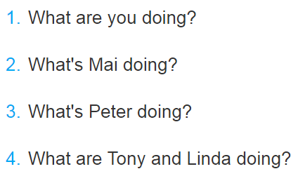




5.Read and match

Slide 15
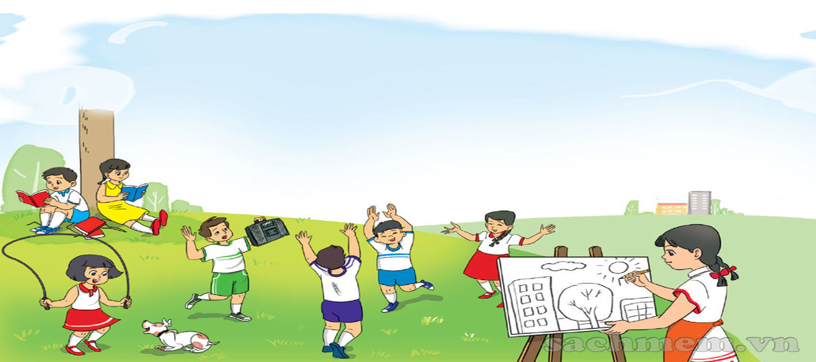
Thanks for watching

Slide 16

What are you doing?
What are you doing?
I'm drawing. I'm drawing.
What is she doing?
She's singing. She's singing.
What is he doing?
He's reading. He's reading.
What are they doing?
They're dancing. They're dancing.

